Slide 1
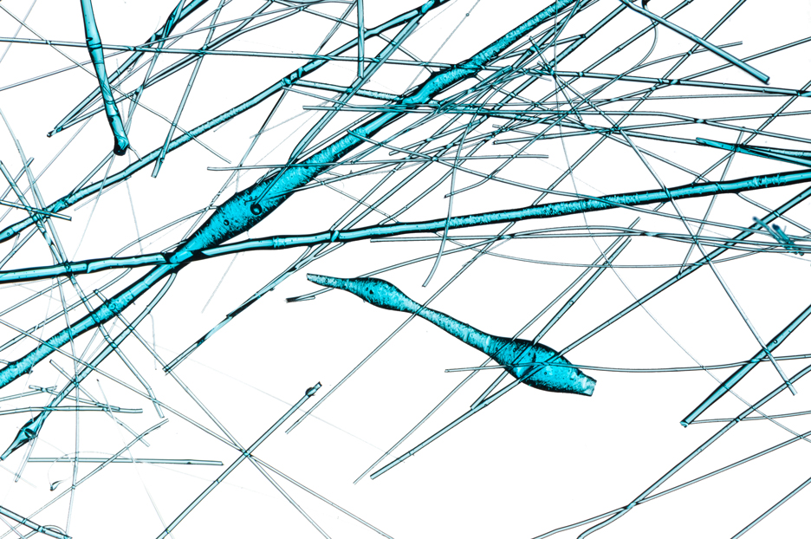

Crash Course
Day 1

Slide 2
Hello!
I am Carl Acampado
I am a member of Accenture Center for IBM Technologies (ACIT)
You can reach me @ carl.t.m.acampado in Skype

Slide 3
9:00 – 10:00
What is Spark? Why Spark? Who Uses Spark and for What?
Day 1 AM Training Agenda
10:00 – 11:30
Spark Ecosystem, Spark Architecture
11:30 – 12:00
Installing Spark Standalone Mode
12:00 – 1:00
Lunch Break

Slide 4
1:00 – 2:00
Spark Core
2:00 – 2:30
Lab 1: Using Spark Core
Day 1 PM Training Agenda
2:30 – 3:00
What is a DataFrame
3:00 – 3:30
Lab 2: Using DataFrames
3:30 – 4:00
What is a Spark SQL
4:00 – 4:30
Lab 3: Using Spark SQL

Slide 5
9:00 – 9:15
Day 1 Summary
Day 2 AM Training Agenda
9:15 – 10:00
What is Spark Streaming
10:00 – 11:00
Lab 4: Using Spark Streaming
11:00 – 12:00
What is Spark MLlib
12:00 – 1:00
Lunch Break

Slide 6
1:00 – 3:00
Lab 5: Using Spark MLlib
3:00 – 3:15
What is Spark GraphX
Day 2 PM Training Agenda
3:15 – 3:30
Lab 6: Using Spark GraphX
3:30 – 4:30
Using IBM Cloud Analytics Engine Service for Spark + HDFS Cluster
4:30 – 4:50
Apache Spark in IBM Mainframe
4:50 – 5:00
Wrap up

Slide 7
EVOLUTION OF DISTRIBUTED SYSTEMS
First Generation:
Proprietary
Custom Hardware & Software
Centralized Data
Hardware-based Fault Recovery
2000s – 2010
1990 – 2000
Second Generation:
Open Source
Commodity Hardware
Distributed Data
Software-based Fault Recovery

Slide 8
WHY DO WE NEED A NEXT GENERATION?
Hardware and software have gone through changes
Big data became a necessity

Slide 9
STATE OF HARDWARE IN 2000
Disk was cheap
Network was costly
RAM was very expensive
Single Core machines were dominant

Slide 10
STATE OF HARDWARE NOW
RAM is king!
Network speed increased
Multi-core machines are now common

Slide 11
STATE OF SOFTWARE IN 2000
Object Orientation was the way
Software Optimization for single core
No open frameworks for:
Distributed Storage
Distributed Processing
SQL was the dominant way for data warehousing

Slide 12
STATE OF SOFTWARE NOW
Functional programming on the rise
Need to exploit multiple cores on a single node
There are good frameworks to create distributed systems
HDFS, S3, MapR-FS, CFS, custom, etc. for storage
Apache Mesos, YARN for distributed processing
NoSQL is a legit alternative/compliment to Relational DB

Slide 13
BIG DATA PROCESSING NEEDS IN 2000
Very few companies have Big Data issues
Batch Processing over Real-time
Volume over Velocity
Mostly used for Search and Log Analysis

Slide 14
BIG DATA PROCESSING NEEDS NOW
53% of companies are adopting Big Data Analytics
Velocity over Volume
Real-time as important as Batch Processing
Use case not limited to Search (Real-time reporting, visualizations, customer/social analysis, predictive maintenance, etc.)

Slide 15
EVOLUTION OF DISTRIBUTED SYSTEMS
First Generation:
Proprietary
Custom Hardware & Software
Centralized Data
Hardware-based Fault Recovery
Third Generation:
Handles real-time and batch
Exploits RAM as much as Disk
Multi-core aware
Can be easily adopted by existing systems
Uses distributed storage and processing technologies
Plays well with Hadoop
2000s – 2010
1990 – 2000
2010 – current
Second Generation:
Open Source
Commodity Hardware
Distributed Data
Software-based Fault Recovery

Slide 16
WHAT IS APACHE SPARK?

Slide 17




















APACHE SPARK HISTORY
2009: AMPLab, UC Berkley
2010: Spark was open sourced
2012: Transferred to Apache Foundation
2011: AMPLab developed higher level components for Spark

Slide 18
WHAT IS APACHE SPARK?
Apache Spark is a cluster computing platform designed to be fast and general-purpose.
It has the ability to run computations in memory ( and disk).
It is designed to cover a wide range of workloads that
previously required separate distributed systems, including batch applications, iterative algorithms, interactive queries, and streaming.

Slide 19
WHAT IS APACHE SPARK?
Written in Scala
Supports Scala, Python, Java, and R
Can be deployed as Stand-Alone or Clustered

Slide 20
WHY APACHE SPARK?

Slide 21


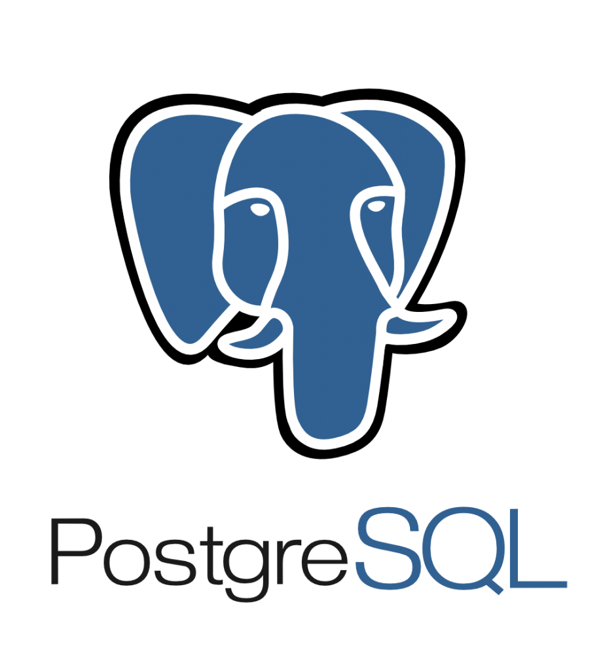








APACHE SPARK PHILOSOPHY
SQL
ML
Unified Engine
1
Streaming
Graph
Support end-to-end applications
High-level APIs
2
Easy to use, rich optimizations
Integrate broadly
…
3
Storage systems, libraries, etc.

Slide 22
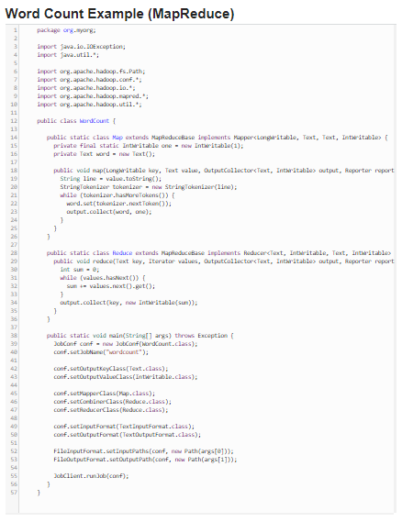
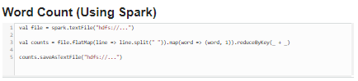
APACHE SPARK Code Complexity

Slide 23
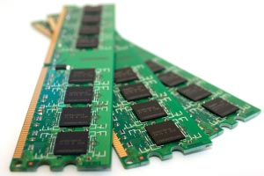
APACHE SPARK In-Memory Processing
MapReduce
Input Stream
MapReduce
I/O Operation
MapReduce
I/O Operation
Apache Spark
Input Stream
I/O Operation
Iterative Algorithms using input data
10-100x faster than MapReduce because of in-memory computing

Slide 24
Sample App: Spam Detection
Spark Streaming
Machine Learning (Spark MLlib)
Input Stream
ALL IN ONE PROCESS!
Query (Spark SQL)
NoSQL

Slide 25
WHO USES APACHE SPARK AND FOR WHAT?

Slide 26
DATA SCIENCE
DATA APPLICATIONS
Data Scientist
Data Exploration
Statistics
Predictive Modeling/Machine Learning
Data Wrangling
Engineers/Developers
Production data processing application
Design and build software systems
Productizing the work of Data Scientists

Slide 27
SPARK ECOSYSTEM AND RUNTIME ARCHITECTURE

Slide 28
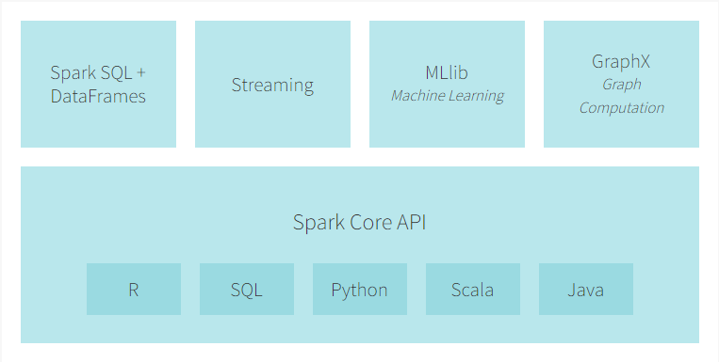
APACHE SPARK ECOSYSTEM

Slide 29
APACHE SPARK RUNTIME ARCHITECTURE
Worker node
Cache
Executor
Driver Program
Task
Task
Spark Context
Cluster Manager
(Mesos, YARN, Standalone)
Worker node
Cache
Executor
Task
Task

Slide 30
APACHE SPARK Deployment
Local Mode
Standalone Scheduler
Hadoop YARN
Apache Mesos

Slide 31
APACHE SPARK LOCAL MODE
Local Node (127.0.0.1)
JVM
Worker node
Cache
Executor
Driver Program
Task
Task
Spark Context
Resource Manager
Worker node
Cache
Executor
Task
Task

Slide 32
APACHE SPARK STANDALONE
Slave Node
Master Node
JVM
Worker node
JVM
Cache
Executor
JVM
Task
Task
Driver Program
Spark Context
Standalone Cluster Manager Master
Slave Node
JVM
Worker node
Cache
Executor
Task
Task

Slide 33
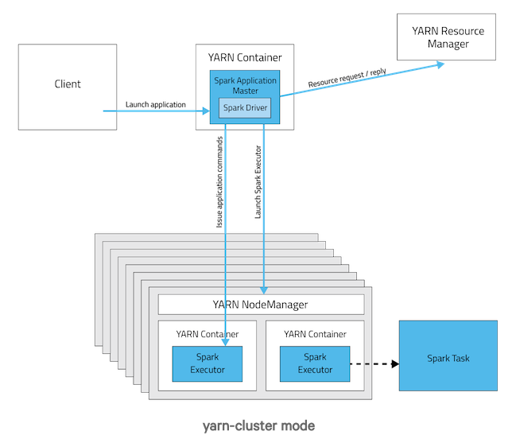
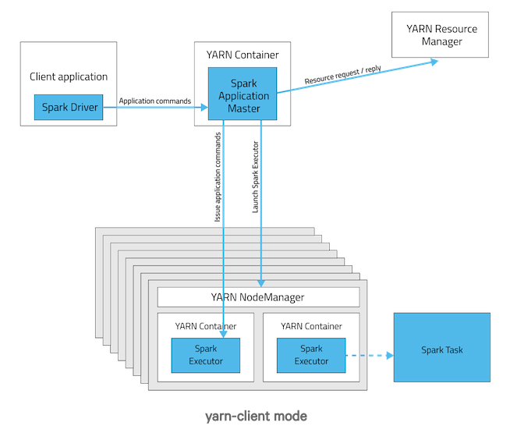
APACHE SPARK YARN

Slide 34

APACHE SPARK MESOS
Mesos Master
Mesos Slaves
Driver Program
SparkContext
Executor
SchedulerBackend
Cache
Fine-grained
Task
Task
Coarse-grained
Task
Task
Task
Task

Slide 35
INSTALLING SPARK STANDALONE MODE

Slide 36
SPARK CORE

Slide 37
SparkContext
SparkContext
Heart of a Spark Application
Represents a connection to a Spark cluster
Main entry point for Spark functionality
Can be used to create RDDs, accumulators and broadcast variables
Only one SparkContext may be active per JVM
RDD
DAGScheduler
Task Scheduler
Scheduler Backend
Listener Bus
Block Manager

Slide 38
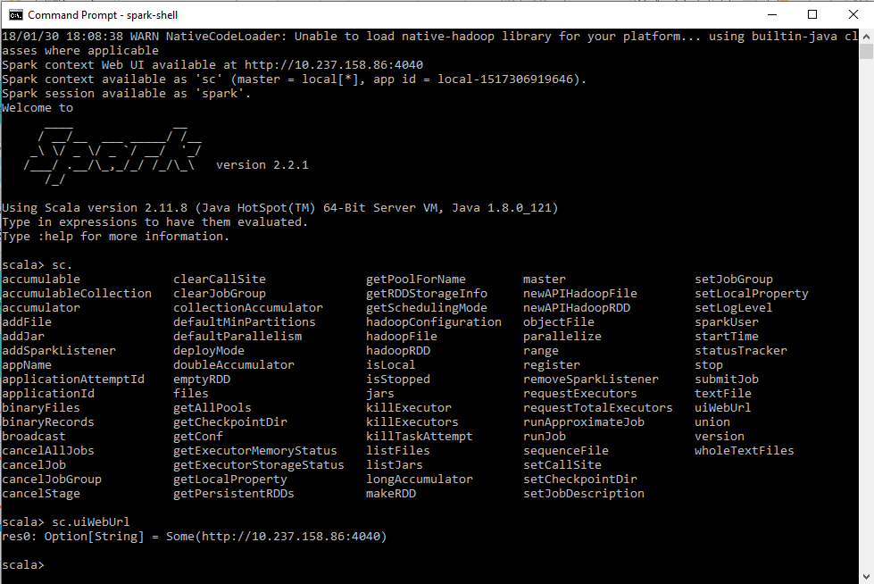
SparkContext

Slide 39
Thanks!
Any questions?
You can reach me via:
Lync/Skype: carl.t.m.acampado
Email: carl.t.m.acampado@accenture.com

